Slide 1



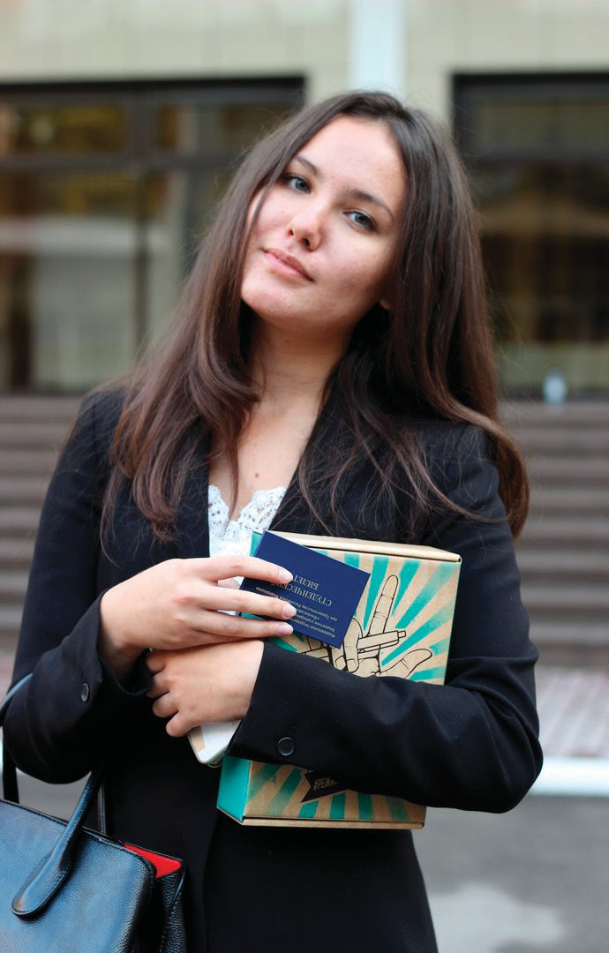

























































































































5 REASONS TO ENROL IN THE BUSINESS AUDIT AND LAW PROGRAMME
Guaranteed employment!
The high demand for graduates and a wide network of partners of the Faculty make it possible to guarantee successful graduates employment in leading auditing, consulting, financial, accounting, analytical departments of Russian and international companies, as well as in tax authorities
In-depth study of financial fundamentals of business functioning, documentation of business operations, methodology of financial control and business audit, business analytics technologies, analysis and forecasting of financial data.
In-depth study of business law, civil law, financial and labour law, necessary for building a successful career in economics and finance.
Specialised disciplines are taught by highly qualified practitioners: chief accountants, heads of services of audit companies, departments of the Ministry of Finance of Russia, employees of tax authorities.
A rich and active student life, many events that develop leadership and organisational skills, teamwork skills (Freshers' Debut and Quest, regular sports competitions in various sports, various projects of the student council and scientific
student society of the faculty).
SSE or Entrance Examination:
- Mathematics (>50 score state-funded; >30 score paid)
- Russian language (>50 score state-funded; >40 score paid)
- Social Science (>55/45 score) or History (>50/35 score) or Foreign Language (>65/60 score) or Informatics (>45/45 score)
COST OF EDUCATION
1-2 years: /year
3-4 years: / year
DISCOUNTS ON PAYMENT (for the first year of study):
80% if the score is from points (88 thousand rubles)
70% if the score is from points (132 thousand rubles)
60% if the score is from points (176 thousand rubles)
50% if the score is from points (220 thousand rubles)
40% if the score is from points (264 thousand rubles)
30% if the score is from points (308 thousand rubles)
20% if the score is from points (352 thousand rubles)
10% if the score is from points (396 thousand rubles).
from the second year onwards, discounts depend on grades
Деканат факультета:
+ 7 915 205 72 55
eelyalkova@fa.ru

