Slide 1












Prototype of Education Program
Work Package 3.1.

Slide 2
Development WP 3 “University-Business Collaboration”
The aim of this WP is to conduct the research among the employers on the competencies that are required for the successful careers and increase of the employability skills of the HEIs graduates and to:
(1) develop and evaluate the evidence base with which to explore the extent of shared understandings amongst stakeholders of key factors in creating and sustaining successful active, reflective work-based learning environments;
(2) develop the accessible innovative resource to guide employers, students and institutions on good practice in supporting effective employer engagement in active reflective work-based learning
(3) develop recommendations to the main stakeholders.
WP 3.2.
WP 3.3.
WP 3.1.
Application Form pp. 55 - 59

Slide 3
Tasks and Deliverables of WP 3.1.
The prototype of education model will be developed around the needs of the BA and MA students to update the generic (soft) and subject-specific competencies that are needed by the labor market of the 21 century. The updated education programs will accelerate students employability chances, and the labor market will get professionals that do need to be re-trained at the working place.
Survey
Gaps Analysis of Competences
Recommendations
WP 3.1. Research Process and Deliverables

Slide 4

Prototype of Education Model
Contents
Introduction
B. WBL best practices in EU Austria France Spain
C. WBL in non-EU countries Russia Belarus Azerbaijan
D. Competence – methodology and survey results IT Management PR Oil&Gas
Policy recommendations for HEIs
F. Further development and transition to UniLab WBL Model

Slide 5
Prototype of Education Model:
Introduction
System of education based on fundamental knowledge and predominance of science over practice;
Shift from planned economy to market economy;
Globalization and IT technologies development;
Definitions in work-based learning and practice-oriented education.
Competences are the foundation of WBL model.

Slide 6
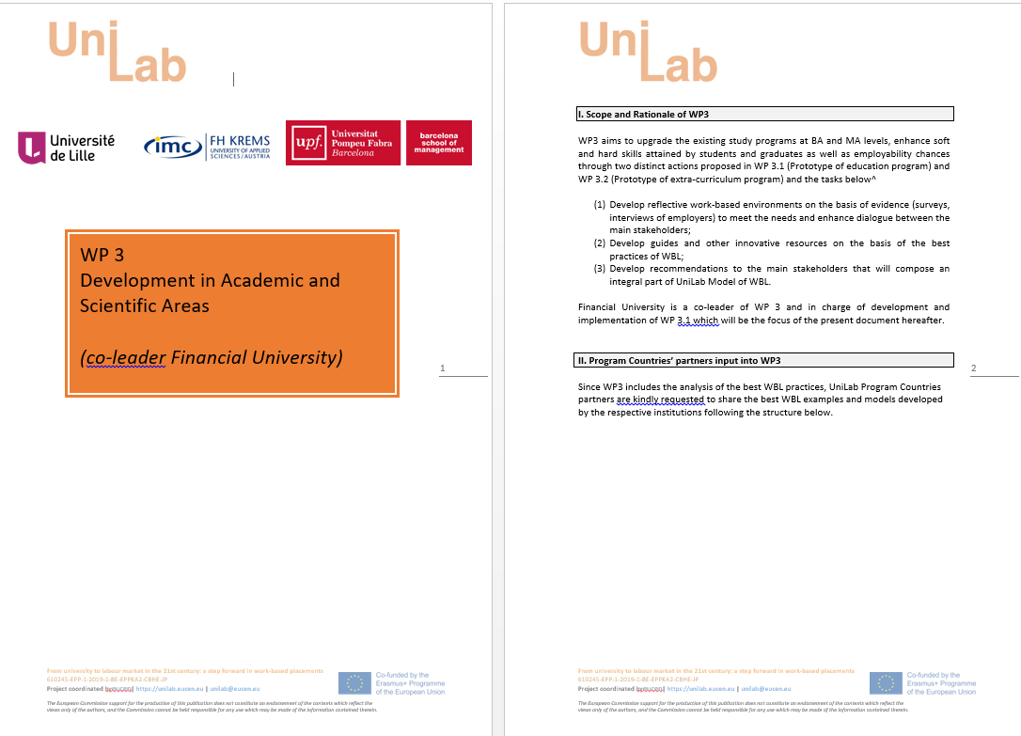
Prototype of Education Model: WBL best practices of EU HEIs
How would you define work-based learning (WBL)?
Could you please describe the main forms and instruments of WBL applied in your institution?
How does your institution analyze the contemporary labor market from the competence-based perspective for BA and MA programs for the majors that are in UniLab focus: (1) IT (2) Management (3) Advertising&Public Relations (4) Engineering (Oil and Gas)?
Can you name core competences for those 4 majors within the concept of WBL? What university structure is in charge of conducting such analytical researches? How are the research results embedded into the educational programs to upgrade them?
What is the impact of pandemic on WBL practices at your institution?

Slide 7
Prototype of Education Model: WBL in
Program Countries (RU, AZ, BY)
National educational systems of RU, AZ and BY prioritize work-based approach in education;
System of education of the Post-Soviet states is still rather theoretical with a tendency to develop hard skills and not paying much attention to transversal skills;
Types of practices adopted by national education systems: educational, industrial and pre-diploma practice.

Slide 8
Prototype of Education Model: Competence Survey and Gap Analysis
Survey of employers
Analysis of job vacancies
Four majors:
Applied Informatics
PR and Advertising
Management
Engineering (Oil and Gas)

Slide 9
Prototype of Education Model: Competence Survey and Gap Analysis
Employers’ requirements | Competences Category
Conducting negotiations, commercial proposal development. Services presentation, finalization and formatting transactions and deals. A full cycle of management (forecasting, planning, administration, coordination, motivation, controlling) Efficient management of a managers’ team, sharing responsibilities, training and motivation, creating incentives for growth and development, performance monitoring Using methods and project work standards in order to improve project management efficiency Acquiring start-up company building skills Skills needed to examine risks, engage in crisis management, an ability to bring new life to business in the short term Development of methodology and regulations in order to build a risk management system and risk management principles within a certain business process and business sector | Bachelor programs Generic Competencies Systemic and creative thinking Project development and implementation, teamwork and leadership Communication skills, intercultural communication skills Subject-specific Competences Ability to solve problems in a professional environment using knowledge of economic theory, theory of management and theory of administration; Ability to gather, process and analyze data needed to solve managerial problems;
 | Master programs General Professional Competences Ability to solve problems in a professional environment using the knowledge acquired (on an advanced level) Ability to use modern data gathering methods and techniques, advanced methods of their processing and analysis
Gap Analysis
Bachelor programs Strategic planning, product sales plan development and implementation; monitoring performance related to commodity circulation Skills needed for B2С/ B2B sales Development of legal norms and regulations
Master programs Budget management Big team management Innovation management
State Educational Standards
Labor Market Demands from Job Advertisements

Slide 10
Prototype of Education Model: Policy Recommendations for HEIs Leadership
Management
The survey showed that the present-day labour market puts stress on the acquisition of risk-management skills, which reflects the nature of business environment nowadays when due to pandemic and unstable economic, political and social situations on a global scale, the future manager should be able to forecast, operate and keep the business afloat irregardless of any crisis.
To introduce modules that train risk-management skills. The future managers are expected to predict, possibly avoid and operate business successfully during crisis.
To enrich the educational programs with different areas of psychology, focusing on personal, inter-personal, organizational and social philosophy. The vast knowledge of psychology is required by the labour market to be able to motivate employees to achieve better work results and develop new incentives.
Within Master programs to introduce teaching/mentoring modules that will develop competences in training, usage of the appropriate methodology to train company’s employees in a number of areas, like team building, communication, motivation, time-management and others.
Bachelor programs Strategic planning, product sales plan development and implementation; monitoring performance related to commodity circulation Skills needed for B2С/ B2B sales development of legal norms and regulations | Master programs Budget management Big team management Innovation management

Slide 11
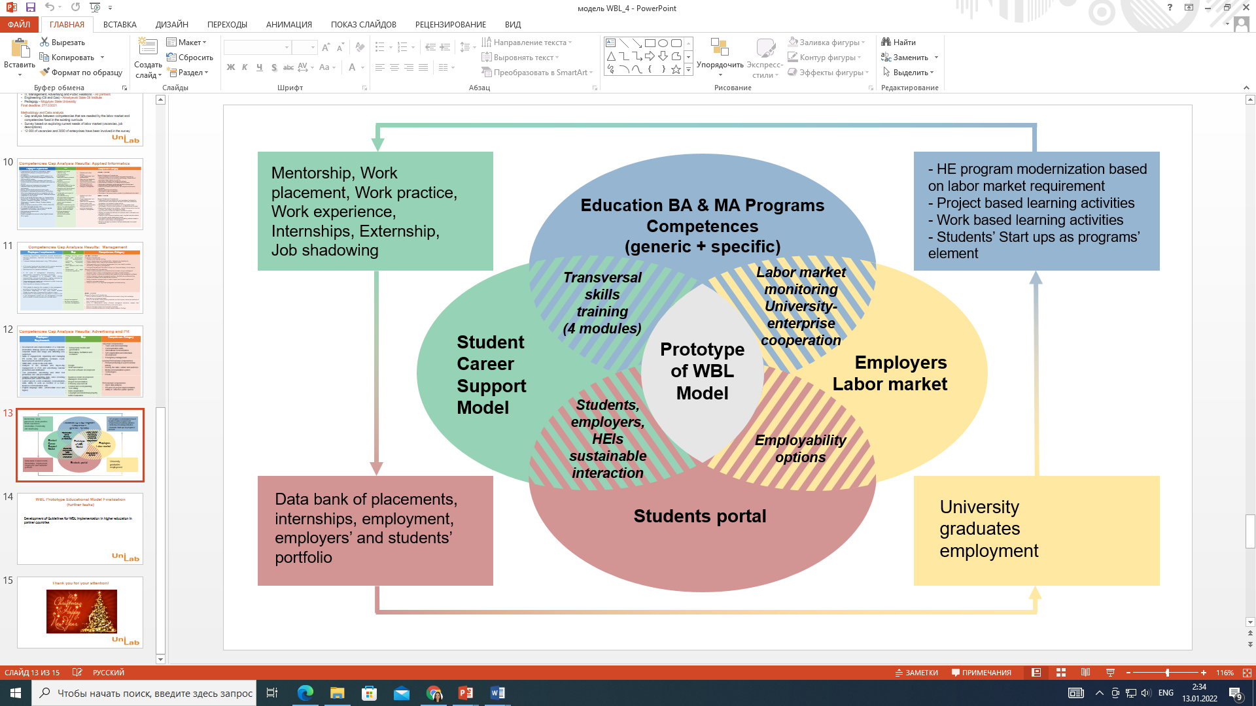
From Competences to UniLab WBL Model
Competences and recommendations for education programs updating;
Extra-curricular programs;
Student Portal;
Student Career Centers (Network).
Graph: UniLab WBL Model

Slide 12

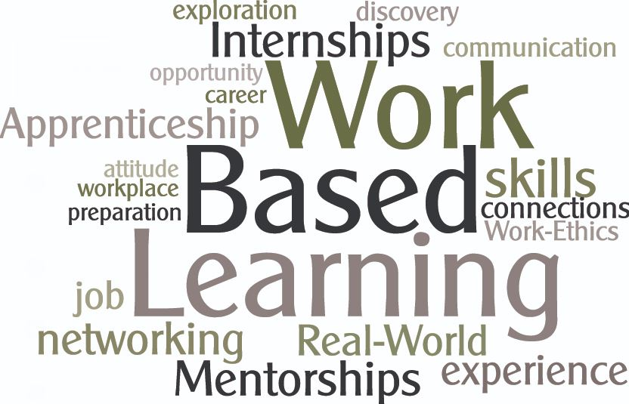
Thank you very much for your support and cooperation!!

