Slide 1


Saxion UAS
and
Financial University
under the Government
of the Russian Federation
DOUBLE DEGREE PROGRAMM

Slide 2

About the Netherlands
Gateway to Europe
Good public transport
Safe environment
‘Highest performing graduates’*
#1 country by English skills**
*Source: OECD report ‘Education at glance’
**Source: EF EPI

Slide 3
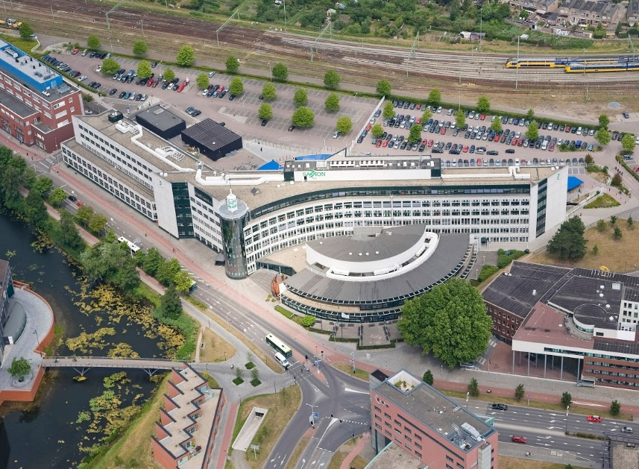
Public university established in 1875
3 campuses in the Eastern part of the Netherlands
  Apeldoorn, Deventer, Enschede
27,000 students and 2,800 employees
  3,500 international students (13% of the total population)
  89 nationalities
13 schools, 6 research groups
Partner universities all over the world!
Quality approved by Dutch government
Academic year starts at the end of August with introduction program for international students
About Saxion UAS
Notes:
1e bullet:
Noemen dat Agreement getekend zal worden gedurende dit event
2e bullet:
>>Jeanet, zelf even naar deze link kijken, dan kun je zien wat er zoal gedaan is, mochten daar vragen over komen.
http://en.mgubs.ru/lomonosov-msubs-holds-international-autumn-business-school-entrepreneurship-and-business-engineering

Slide 4

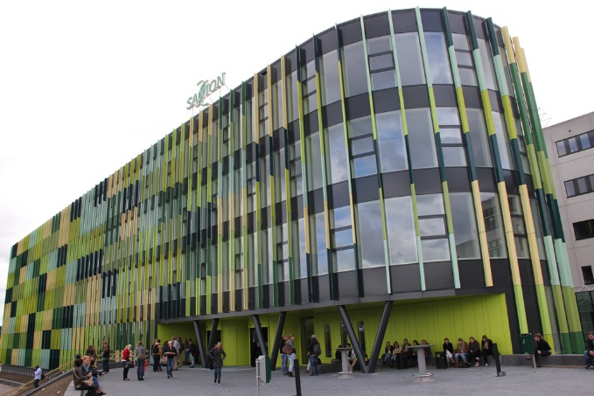
Saxion UAS Deventer
City founded around 800
Hanseatic city
99,653 inhabitants

Slide 5

About
School of Finance and Accounting
1,203 students
121 international students
10% international student population
27 nationalities within our school
114 staff members
Based in Deventer and Enschede

Slide 6



Double degree programme
BSc International Finance and Accounting
After successful completion of three years’ of study in FU International Finance Bachelor (IFA) programme,
FU students can continue studying in Saxion UAS.
The length of this programme is two years.

Slide 7

BSc International Finance and Accounting Subjects and credits

Slide 8

ONE YEAR Double degree programme BSc International Finance and Accounting
Students can only be admitted into the ONE YEAR programme if the content of
Ethics 3.1,
Corporate Governance 3.1,
Sociology and Cultural Anthropology 4.3,
Human Resource Management 3.2 is included in (or added to) the study programme of FU.

Slide 9
Financial information
Our fee-structure consists out of four parts. These fours parts together make our total package fee, which is an amount covering all study costs. Living expenses are not included in the total package fee.
The fee-structure consists of:
Tuition fee: the costs of the course, you can find the tuition fee for each programme on the programme details pages;
Housing: in the first year you are obliged to rent the accommodation Saxion arrange for you;
Visa & residence permit: Saxion takes care of the procedures necessary for you to come to the Netherlands;
Insurance.
More information?
https://www.saxion.edu/studying-in-the-netherlands/practical-matters/fee-structure

Slide 10
Tuition fee for BA programme
Tuition fee € 7,800
Housing1 € 5,050
Visa / Residence permit € 220
Insurance € 525
Total package fee € 13,595
Prices of housing are maximum amounts. In addition to the rental fee, we require a
deposit of € 500. For further information check Housing - Terms & Conditions.

Slide 11
Saxion scholarships
We are proud to offer scholarships to talented international students that apply for a bachelor or master programme at Saxion:
Holland Scholarship (HS)
Saxion Talent Scholarship (STS)
Orange Tulip Scholarship (OTS)
More information?
https://www.saxion.edu/studying-in-the-netherlands/finance-your-studies/scholarships

Slide 12
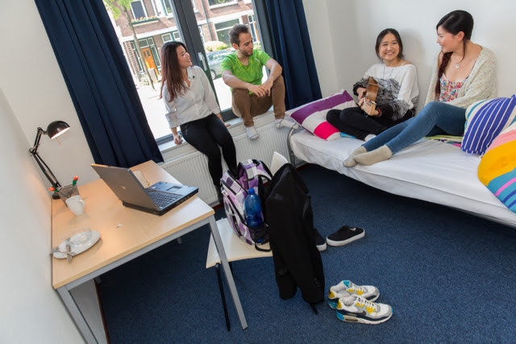
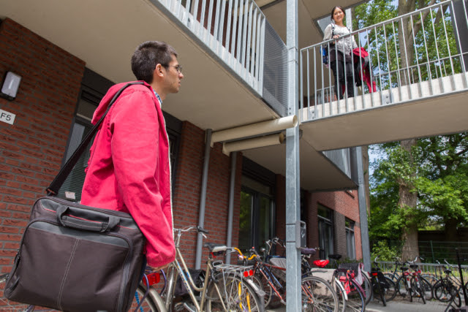
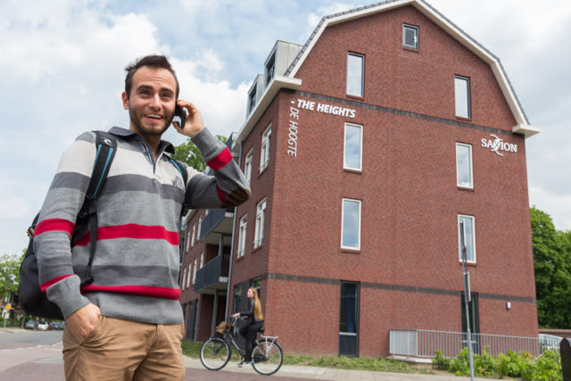
Accommodation
Off-campus
Residential areas
Bicycle or public transport to campus
Broadband Internet access
Private bedroom
Share bathroom / kitchen
3-5 students per apartment
Mix of nationalities

Slide 13
Application information
International Finance and Accounting - short degree programme
Application deadline: June 1, 2020
Deadline for payment: July 1, 2020
Introduction: August 26 – 28, 2020
Start of the programme: August 31, 2020
More information?
https://www.saxion.edu/programmes/bachelor/international-finance-and-accounting-short-degree-programme

Slide 14
Working in the Netherlands
You need a working permit for your part time job. Your employer needs to apply for it;
You need a valid residence permit;
You need to apply for a citizen service number;
You need a Dutch Basic health insurance;
Maximum 16 hours a week or full time during the summer (June, July and August).

Slide 15





Saxion
@social media
SaxionUniversity
@SaxionUAS
@SaxionUAS
/SaxionUAS
international.fem@saxion.nl
internationaloffice@saxion.nl
housing@saxion.nl

Slide 16
Contact details
Saxion University of Applied Sciences
School of Finance and Accounting
Ms. Jeanet Nijland
international.fem@saxion.nl or j.h.nijland@saxion.nl
T+31(0)88 019 3845 or M +31(0)6 203 10 851
www.saxion.edu

