Slide 1
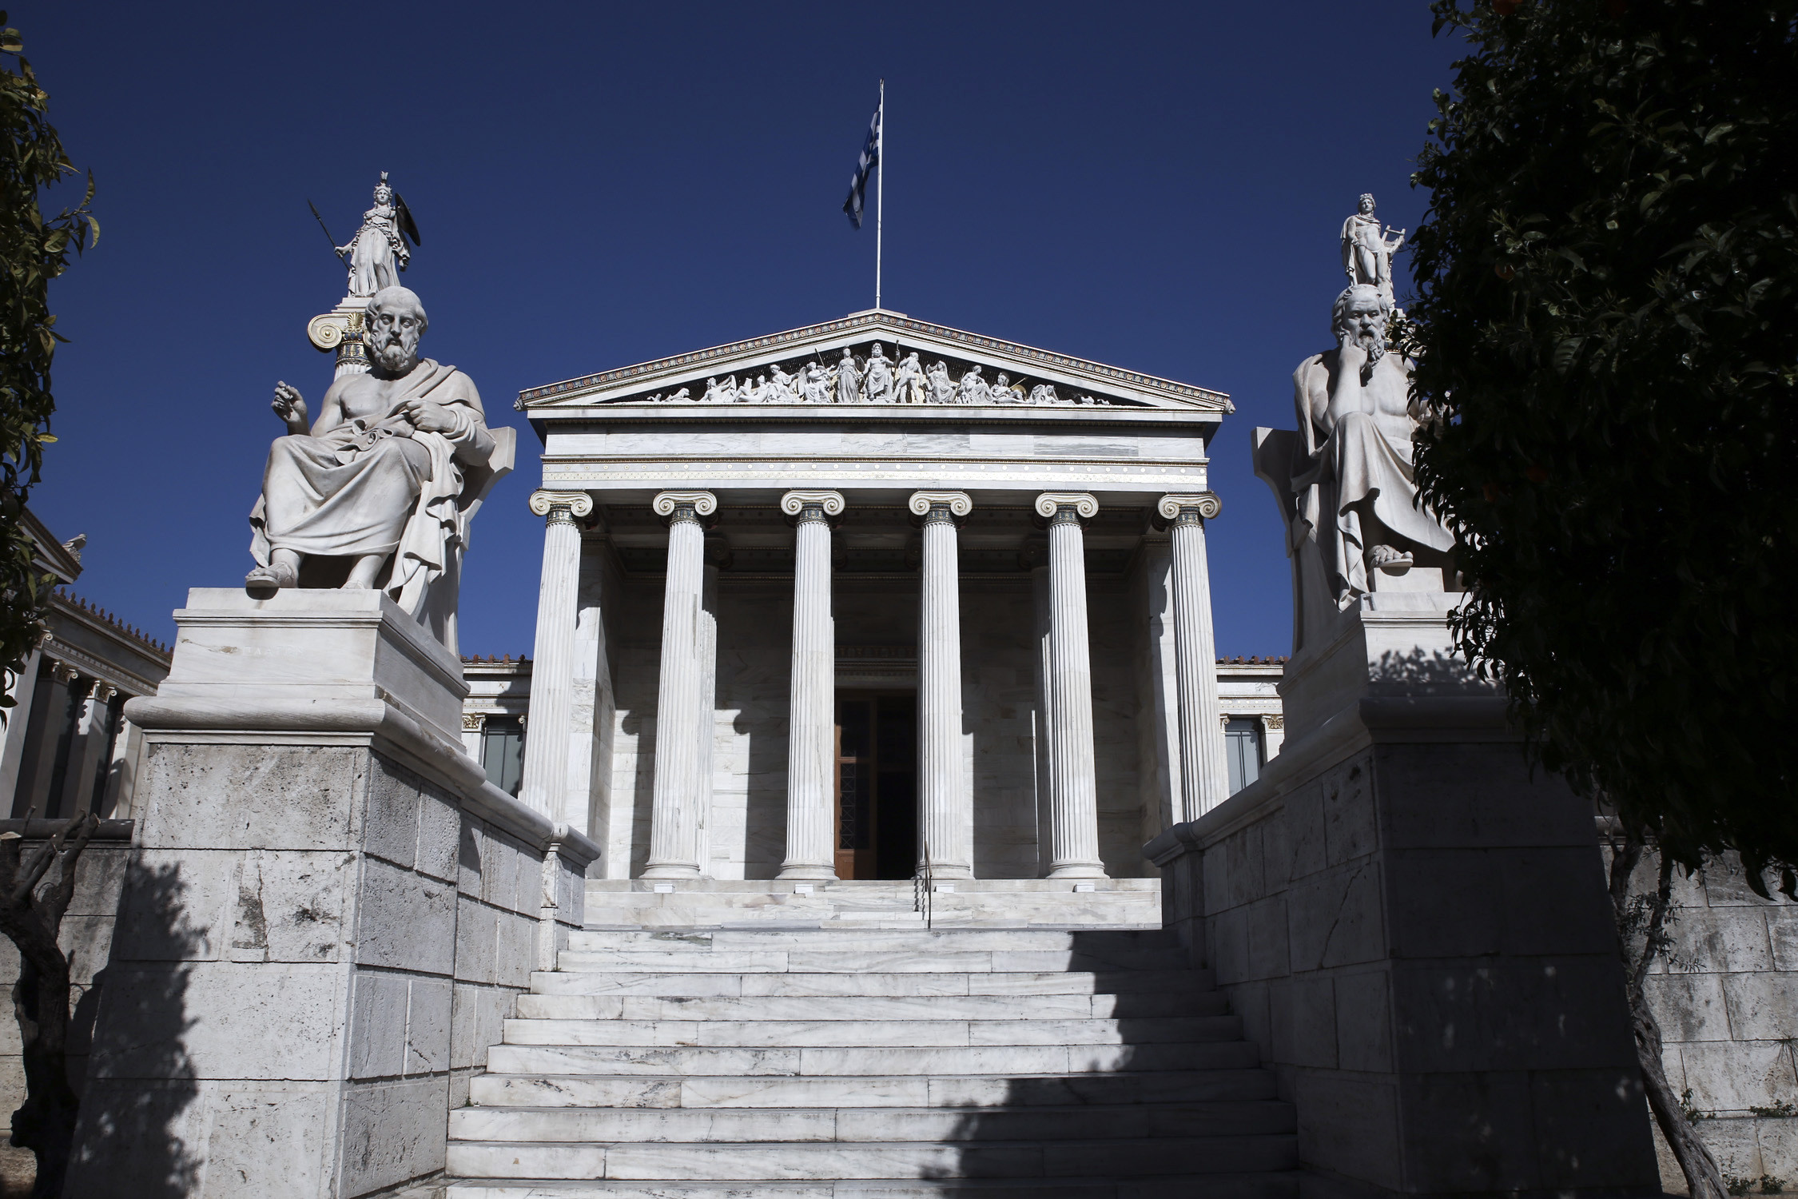
Aristotle on money and [briefly] on crisis
Catherine Bregianni
Academy of Athens

Slide 2
An ontology of money in Aristotelian texts [Nicomacheina Ethics, Politics, Athenian Constitution]. 4th century bC.
Money as an institutional being
-objective factors : social elites ’identification to wealth
Link of the market to commercial transactions and accumulated capital
-subjective factors : ‘’ου φύσει αλλά νόμω εστί = it is not existing in nature but only by law’’ NE, V.
Money is qualified as measure of exchange, but also as means of exchange
Money as a social symbol
-Social qualities related to money’s demand
-Global economic and social relations are represented by money as an epiphenomenon

Slide 3
Some Aristotelian concepts on crisis
Crisis is related to objective factors : social disorder is a consequence of structural transformation
Economic crisis is leading to political crisis (examined in the basis of the Athenian paradigm, 6th century bC.).
Economic bases of the crisis is leading to individual depression:
‘’νοσούντες τα προς ευατούς =citizens are suffering regarding themselfs’’ Athenian Constitution

Slide 4
Money’s usage
Private economic activity is related to city-state’s welfare
Economic and political structure are interrelated
The ‘’national’’ wealth must go along with the moral dimension of the city-state.
Political science is considered by the philosopher as a superior science, but this should be connected to economic art.
Economic studies are classified among applied sciences.

Slide 5
Aristotle’s dialectical approach of economic activity
Applied economic activity is separated from financial activity
Applied economic activity is compatible to nature
Financial activity is unnatural

Slide 6
Money’s qualities
The use of money was born by necessity
Labor cost is integrated to the commodities value
Currency has both, inner and institutionalized value
Human freedom is identified to self-determination in monetary transactions
Money can be devaluated, withdrawn from circulation and falsified (subjective quality)
Article’s prices are specified by demand (objective quality)

Slide 7
Athenian tetradrachm (5th bc)

Slide 8
Tetradrachm’s Diffusion in eastern Mediterranean

Slide 9
Conclusion
Aristotle applies a dialectical method based in materialism
Social relations are determined by economic structures
In the city-state, social stratification is based on wealth possession
An opposite epistemological framework is Plato’s idealism

