Slide 1
SEMIOTICS OF THE COINS A new look at key concepts and central problems
ALEXANDER V. AKOPYAN
(MARJANI INSTITUTE OF HISTORY, TAS)

Slide 2
The aim of the scientist is to determine
what is a whole, and that is part of;
what is old and what is new.
François Baudouin (1520-73)

Slide 3
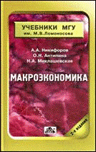
What is the coin? (MSU TEXTBOOK, 2008)
“Symbolic” coins:
i. e. modern coins of non-precious metals,
no inner value, only decret value
COINS
“Commodity” coins “has inner value”:
“metal value = face value” (AV, AR and Æ coins)

Slide 4
What is the coin? (350 BC)
PERMISSIVE INTERPRETATION OF ARISTOTLE’S PHRASE
“Of this the value was at first measured simply by size and weight, but in process of time they put a stamp upon it, to save the trouble of weighing and to mark the value.”
Aristotle, Politics 1:9
NOT CORRECT, AS ALL COINAGE IS DECRETIVE (FIAT):
“Money has become by convention a sort of representative of demand; and this is why it has the name ‘money’ (νόμισμα) — because it exists not by nature but by law (νόμωι) and it is in our power to change it and make it useless.”
Aristotle, Nicomachean Ethics 5:8

Slide 5
What is the (monetary) system?
Systems, i.e., complexes of elements standing in interraction.
L. von Bertalanffy, 1968
System is a holistic entity, consisting of elements in the
mutual relations.
V. M. Solntsev, 1971
System is delimited set of interacting elements.
A. N. Averyanov, 1985

Slide 6
What is the monetary system?
European numismatic tradition: necessary data about the monetary system formulated via set of standard weight of coin + coin denominations + composition of alloy (cf. Grierson, Bendall, Sear).
Vengler, Gierow, Unger (1976):
Monetary system – set of different coin denominations grouped by the types (full current coin or a small coin), fractions, functions and standards of alloy.
Is it enough?

Slide 7
Symbolism of the coins
1. Coins are important in their own system of monetary circulation not so much due to their substantial properties (weight, fineness or metal), but because the attributed property (nominal value), that radically distinguishes them from any kind of (stamped) ingots.
2. Systems of this kind of objects that have arisen “due to human activity as a means of securing and expression of semantic concepts” called secondary material systems, set against the primary material systems (in which material objects are significant in themselves) and ideal systems (systems of ideas, concepts, etc.).
3. Such systems are called sign, or semiotic systems; among other such systems include the language. As in language, in the monetary system the substantial nature of the elements is indifferent to the use of these signs.

Slide 8
Elements of monetary system
BASIC UNIT, characterized by a certain weight and the fineness of metal (which are collectively called "monetary standard")
MINTED COINS
COUNTING UNITS

Slide 9
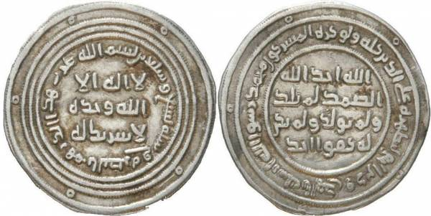
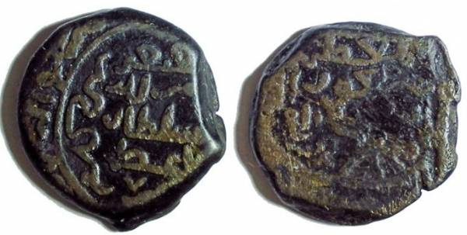
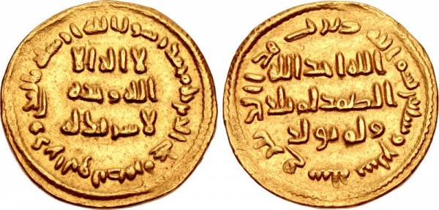
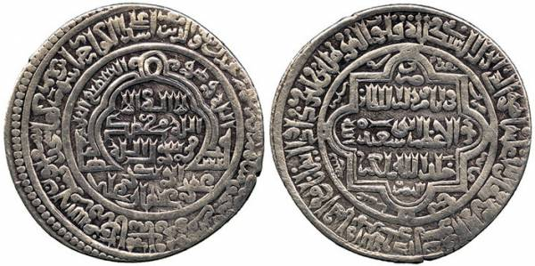
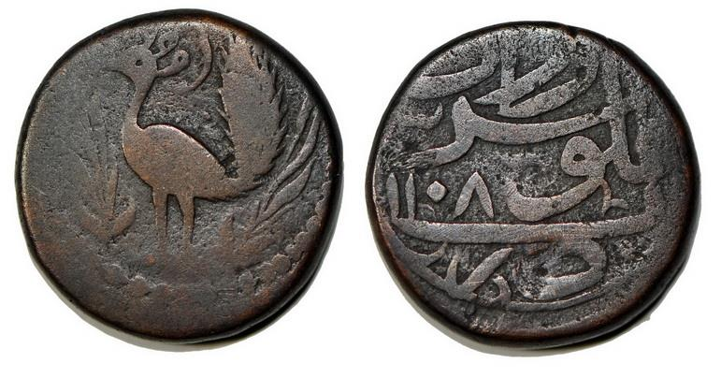
Decretivity of money removes the restrictions on the determinancy of the use of a different material elements
Language: red light, ‘stop’ =
vs.
Monetary systems:
Silver dirham, 7th c.
Copper dirham, 12th c.
Gold dinar, 7th c.
Silver dinar, 14th c.
Copper 10 (!) dinars, 18th c.

Slide 10
Structure of the monetary system
BASIC UNIT
COUNTING UNITS
MINTED COINS
COUNTING SYSTEM
& THE MULTIPLICITY
OF DENOMINATIONS

Slide 11
Substance of the monetary system
As substance of monetary system can only be considered the concept of the coin itself –
institutionalized public release of a medium of circulation.
Perhaps there is a key difference between the monetary system and a language system –
in the language, substance is material (sounds) and has the ideal properties (expression and differentiation of values), whereas in the monetary system, since the invention of money, substance is ideal (nominal value).
If at the beginning coins were continuation of the pre-monetary material forms of money (‘commodity-money’), in the coin period it takes over from them only the external features, sharing with commodity-money some common parameter as weight, metal, name, nominal value etc., but not equivalent value.

Slide 12
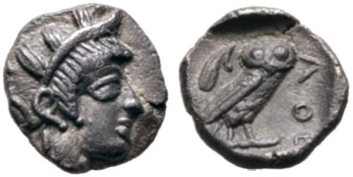
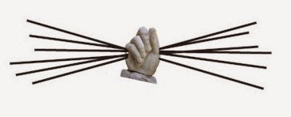
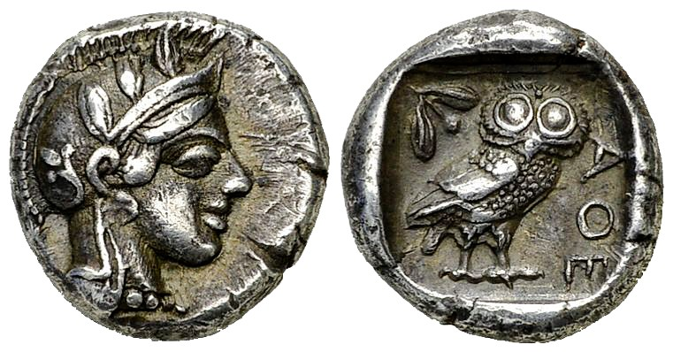
Athens. Obol (ὀβολός) = 1/6 of drachma, 0.67 g
A handful (δραχμή) of 6 twigs (ὀβελός)
Athens. Drachm (δραχμή), 4.26 g

Slide 13
Coin: tools, rule, type
NUMMULARY TOOLS – variable parameters of coins, which determine its design.
There are four type of parameters:
textual,
extra-textual (images, patterns, cartouches, etc.),
metrological (shape, weight, size, thickness, fineness for coins made of precious metals)
technological (striking / casting, homogenous alloy / fourée / enriched on the surface).
NUMMULARY RULE – historically and culturally conditioned preferences in the selection
and use of prevalent nummulary tools, which are accepted by the state as most demand at a particular historical period.
COIN TYPE – stable set of inscriptions (on the obverse and the reverse) and used decorations.

Slide 14
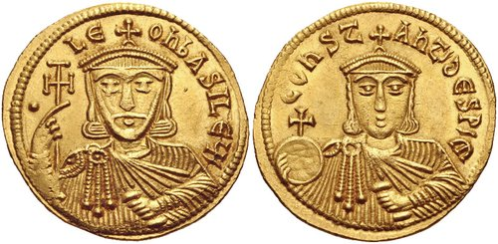
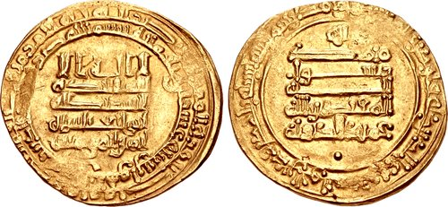
Coin’s language grammar
PROTOCOL is a set of textual nummulary tools.
Major groups of sources for protocol:
a) stable formula of introductions the documents,
b) religious phrases and prayer treatment,
c) translation of stable formulas from foreign-language coin,
g) official titulature,
d) direct references to the ratio between the units.
Leo V Armenian (813-820)
Coin protocol is direct oration of the emitent
COIN IS EQUAL TO THE EMITENT
al-Muqtadir (895-932)

Slide 15
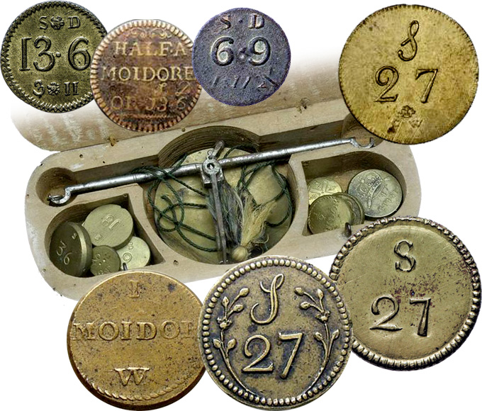
CoinS: govermental & private
COIN IS THE STATE ACT.
History of the exaggeration of the values of coin weight in the monetary system is likely begins with a late Renaissance tradition of cataloging of coin collections and descriptions of coins with their weight.
“Of this the value was at first measured simply by size and weight, but in process of time they put a stamp upon it, to save the trouble of weighing and to mark the value” (Aristotle, Politics 1:9).
RULE:
issue of the coins
accepting of duties
EMITENT RECIPIENT

Slide 16
SEMIOTICS OF THE COINS A new look at key concepts and central problems
Thank you for attention
ALEXANDER V. AKOPYAN
(MARJANI INSTITUTE OF HISTORY, TAS)
alexakopyan@gmail.com

