Slide 1
Project implementation report
Financial University under the Government of the Russian Federation
Karakol, 9-15 July 2017

Slide 2
Financial University Team
Rozanova Tatiana, Vice Rector for Continuous education
Subanova Olga, Deputy Dean of Faculty of International tourism, sport and hospitality business
Liliya Prikhodko, Head of International Relations Department
Yury Schegolkov, Deputy Dean of Faculty of International tourism, sport and hospitality business
Konstantin Levchenko, senior teacher

Slide 3
Project implementation
Work Package 1:
Analytical report on the tendencies of the tourism market development and employers’ needs has been completed and presented during project seminar in St. Petersburg.

Slide 4
Project implementation
Work Package 2
QS “Destination development” having both national and EU values has been developed.
QS has been reviewed and approved by professional tourist association and by Ministry of Labor & Social Protection
QS “Destination development” generally has been approved by the Ministry of Education and Science of Russian Federation, the detailed recommendation for its improvement will be given shortly.

Slide 5
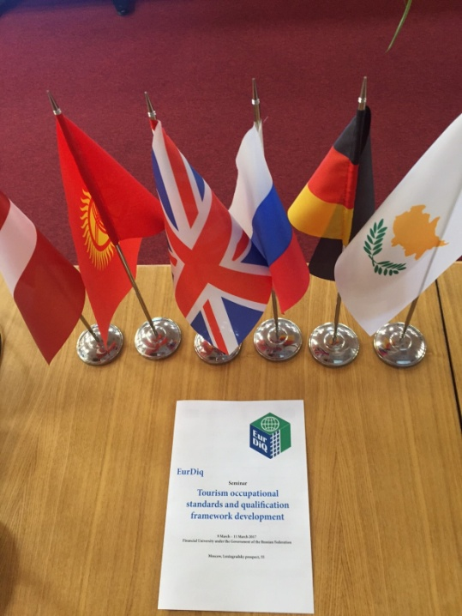
Project implementation
Work Package 2
Approval seminar “Tourism occupational standards and qualification framework development” has been organized in Moscow in March 2017
Developed QS has been presented to the EU experts and stakeholders (industry representatives, employers, governmental bodies, professional associations)
QS has been improved based on experts’ feedback

Slide 6
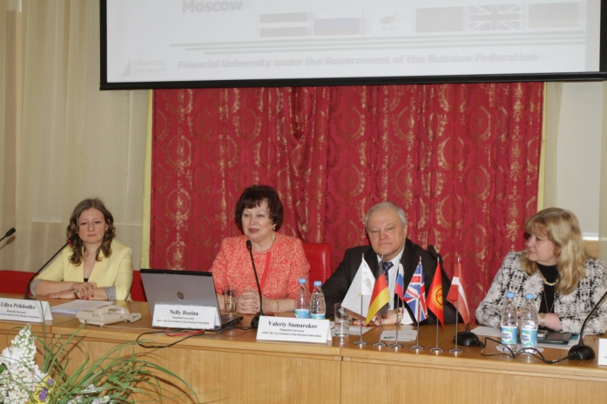
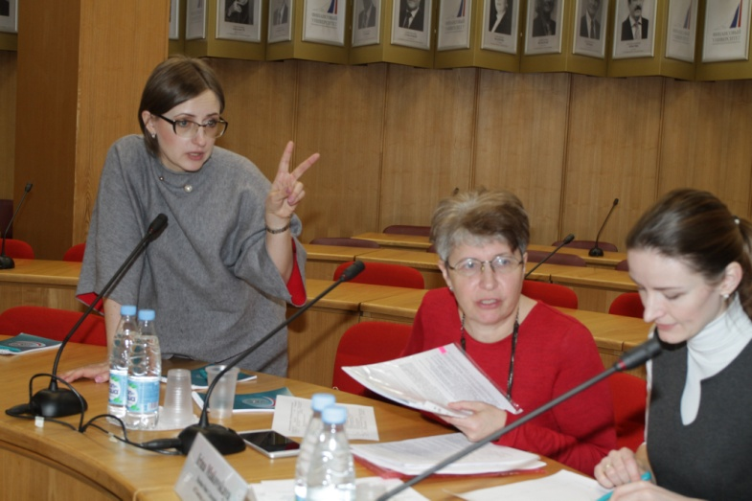
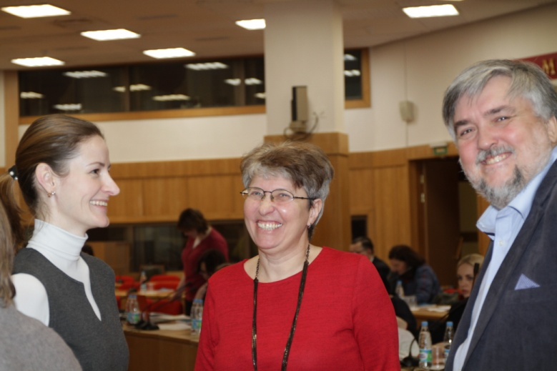
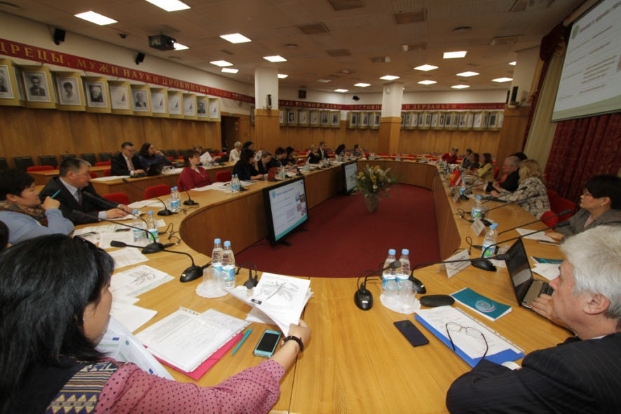
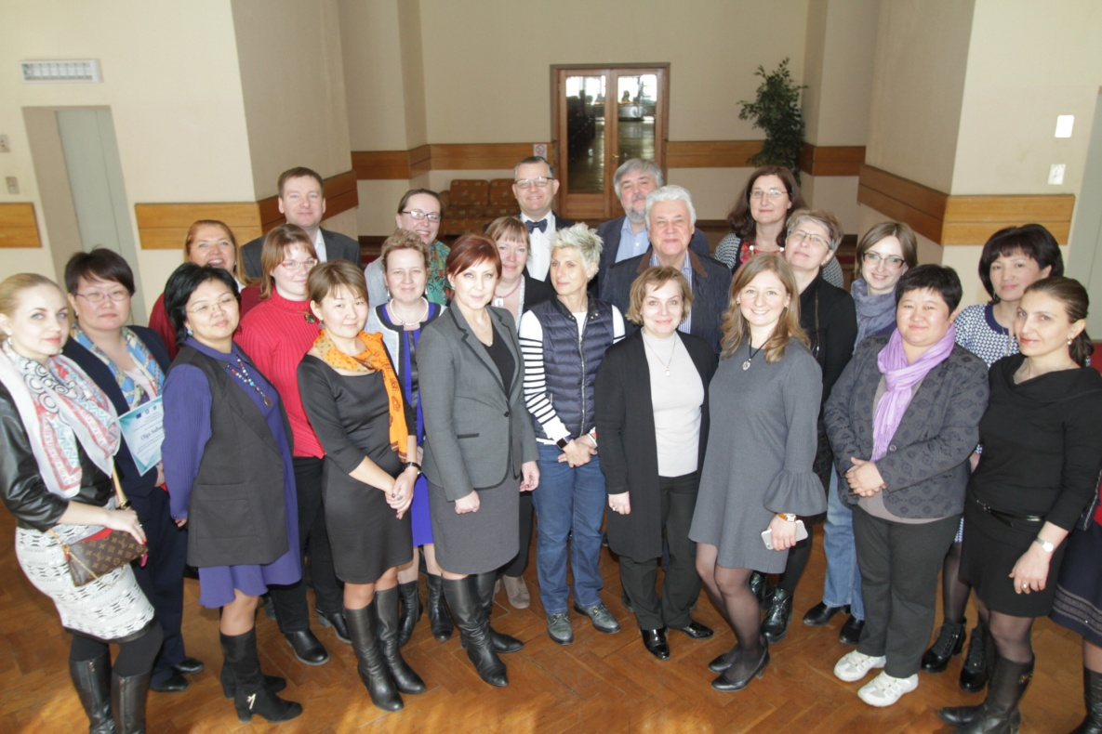
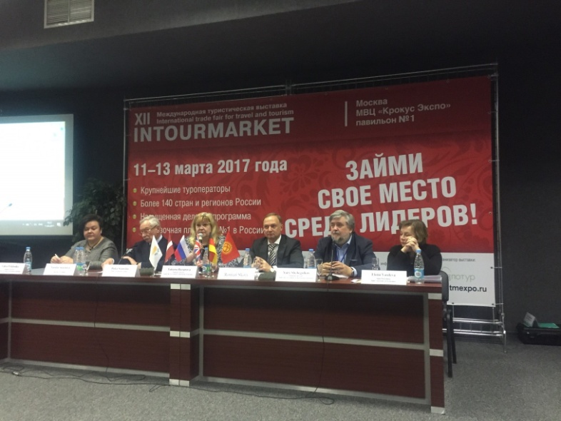
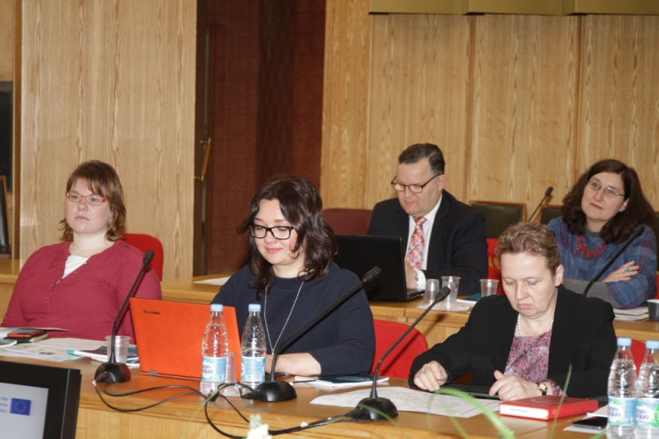
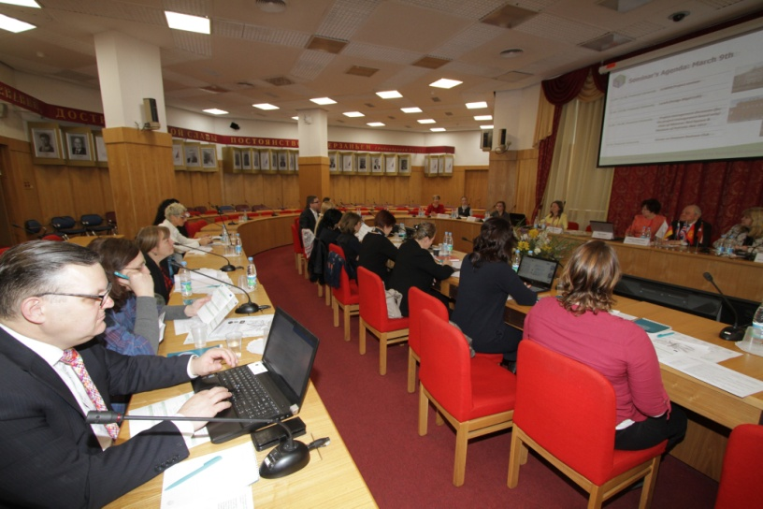
Project implementation
Memories:
Moscow seminar “Tourism occupational standards and qualification framework development
March, 2017

Slide 7
Project implementation
Work Package 3
3 Financial University teachers have participated in the training program in Cyprus
Work Package 4
4 syllabi have been developed:
Budgeting process
Management of tourism destination
Tourism destination development
Marketing destinations
Dissemination and Management

Slide 8
Project implementation
Looking forward for the next step!
Thank you!

